Slide 1

Hi,
I am SUMAIYAH

Slide 2
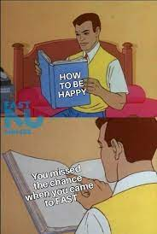
How to Survive in FAST?
Have fruits/snacks in your bag.
Tune in your sleep schedule.
Do networking/rest in point. Utilize your point time.
You will cry a lot here. So keep tissues with you.

Slide 3

How to Survive Programming Fundamental?
Don’t Cheat Yourself!
I have a 0 tolerance on cheating.
3 hours of practice each day.

Slide 4
Google Classroom
BS(RA)-1A dn7vcyn
BS(RA)-1C rx5was7
Marks Distribution:
Mid-1 : 15
Mid-2 : 15
Assignment: 10 (Three Assignments)
Quizzes : 10 (Three Quizzes)
Final : 50

Slide 5
P.S. These slides are useless if you do not attend classes

Slide 6
How you got admission in FAST?

Slide 7
INPUT?
Process? OUTPUT?

Slide 8
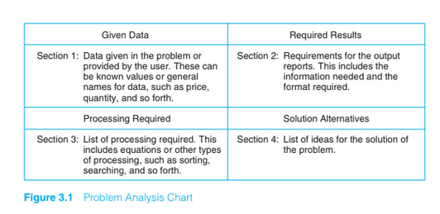
Problem Analysis Chart

Slide 9
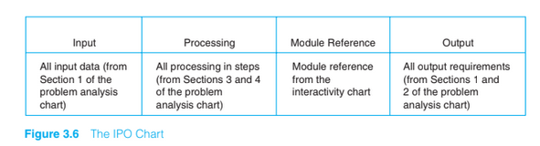
IPO Chart

Slide 10
Tasks
Calculating area of a circle.
Converting marks to percentage.

Slide 11
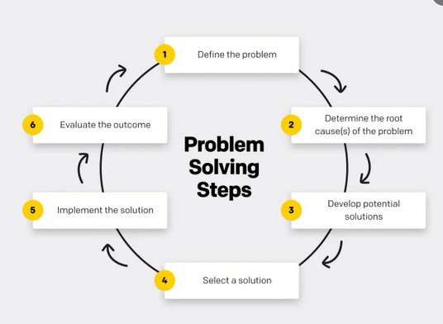
Problem Solving Approach

Slide 12
Algorithm VS PseudoCode
An algorithm is a step by step procedure to solve a problem.
Pseudocode is an informal way of writing a program. It represents the algorithm of the program in natural language and mathematical notations.

Slide 13
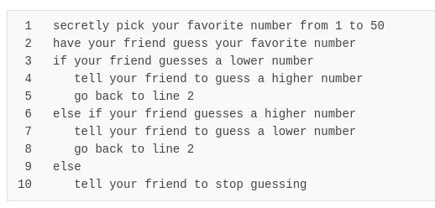
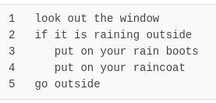
Pseudocode ~ Fake-code

Slide 14
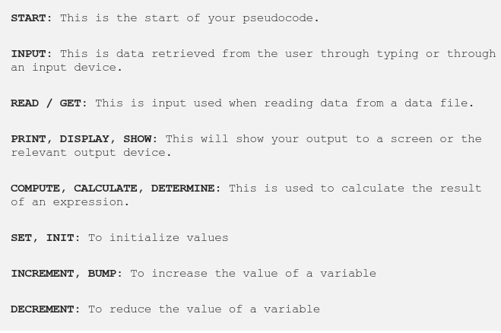
Pseudocode Keywords

Slide 15

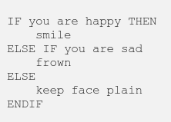
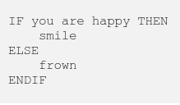
Conditional Statements

Slide 16
Pseudocode for adding two numbers
Start
PRINT “Please enter two numbers to add”
READ num1
READ num2
Sum = num1+num2
PRINT Sum
End

Slide 17
Practice Problem
Make a simple calculator which takes 2 input numbers and do basic arithmetic operations of mathematics such as addition, subtraction, division and multiplication.
Write a pseudocode and draw PAC and IPO chart.

Slide 18
Problem
Draw PAC and write a pseudocode for a problem to read two numbers. The first number represents the unit price of a product and the second number represents the quantity of the product sold. Calculate and print the total sale.

Slide 19
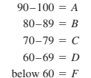
Practice Problem
Design a program for calculating a student’s letter grade according to the following criteria
Write a pseudocode and draw PAC and IPO chart.

Slide 20
Home Assignment
Make PAC, IPO chart and write a pseudo code for all steps required to sign up Facebook.
Repeat everything for Facebook Login.

Slide 21
Home Assignment
Make PAC, IPO chart and write a pseudo code for all steps required to calculate ride cost for a person who wants to commute through Careem. Make necessary changes to accommodate different ride types.

Slide 22
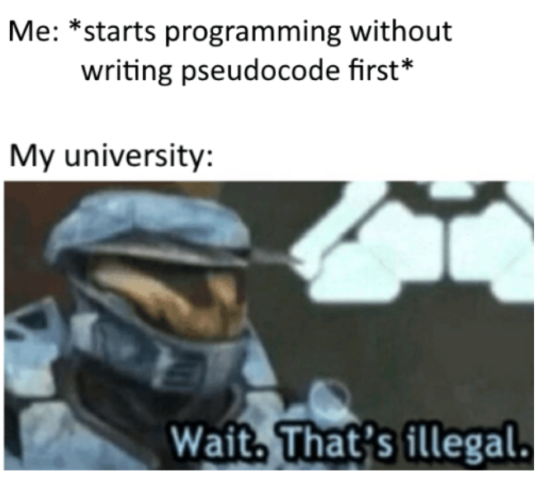
Start
Eat
Sleep
Code
If tired
Take a rest
End

Slide 23
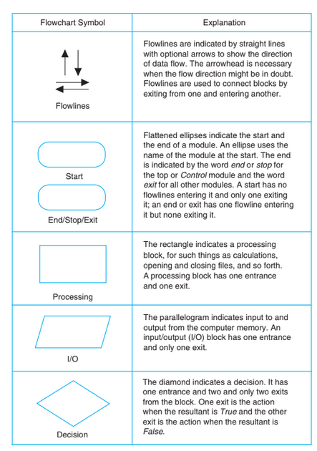
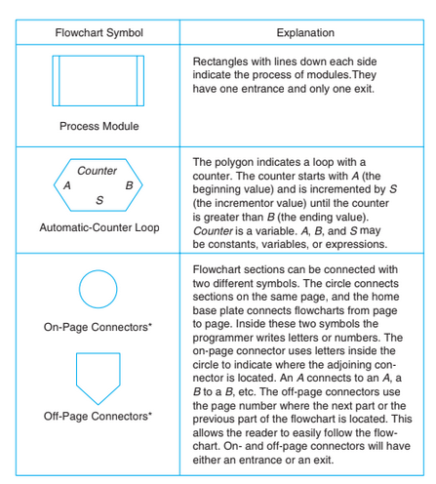
Flow Chart

Slide 24
Tasks
Make a flowchart for calculating area of a circle where radius is taken from the user.
Make a flowchart for converting subject marks (input from user) to percentage.

Slide 25
Practice Problem
Make a simple calculator which takes 2 input numbers and do basic arithmetic operations of mathematics such as addition, subtraction, division and multiplication.
Make a flowchart.

Slide 26
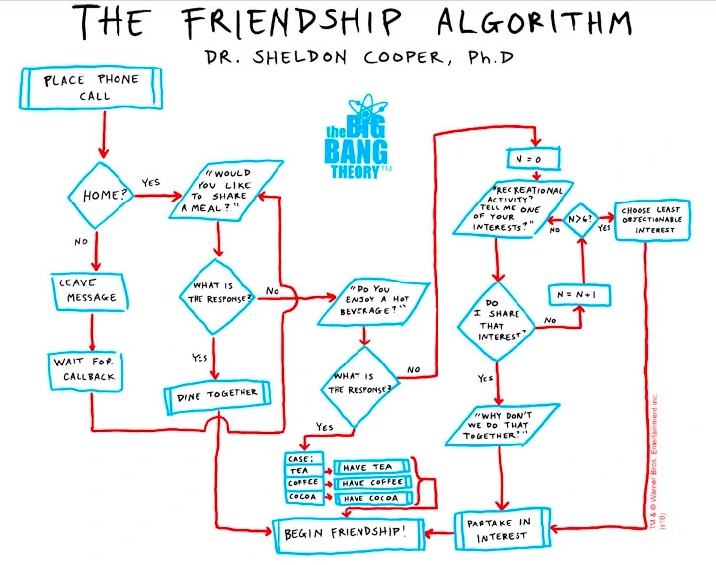
Friendship Algorithm

Slide 27
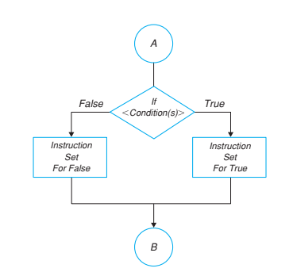
Decision Logic Structure If/Then/Else
Calculate the pay for an employee at an hourly rate of 100 Rs and overtime pay (over 40 hours) at 1.5 times the hourly rate.

Slide 28
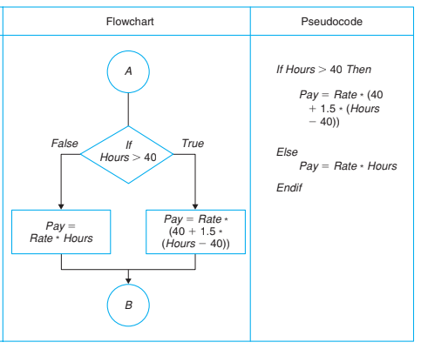

Slide 29
Practice Problem
Ask user his/her marks in an exam, show the result pass or fail depending on the marks. Below 50 is fail.
Make a flowchart.

Slide 30
Practice Problem
Write a program to check whether a triangle is valid or not, when the three angles of the triangle are entered through the keyboard. A triangle is valid if the sum of all the three angles is equal to 180 degrees.
Write a pseudocode and make a flowchart.

Slide 31
Practice Problem
Any integer is input through the keyboard. Write a program to find out whether it is an odd number or even number.
Write a pseudocode and make a flowchart.

Slide 32
Nested If/Then/Else
Calculate the pay for an employee on the following conditions:
Fixed Salary or Hourly salary
For employees working on hourly salary, If working hours are greater than 40 hours, overtime would be paid at 1.5 times the hourly rate.

Slide 33
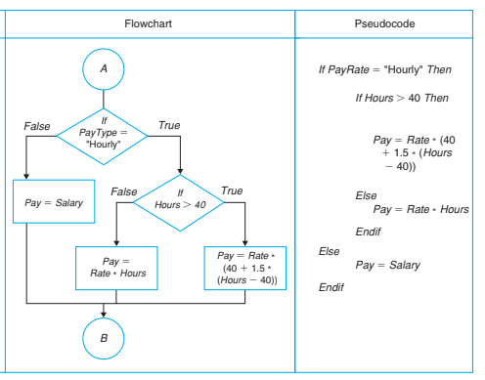

Slide 34

Practice Problem
Make a flowchart for the charges of a train ticket based on the ages of people.

Slide 35
Practise Exercise
Make a flowcharts for calculating a student’s letter grade given the following
Write the Calculation module to choose the largest number from a set of three numbers A, B, and C. Write the pseudocode and draw the flowchart.
Joan is planning her vacation. She is considering two different destinations. She would like to go to the one that will be less expensive for the total trip including gas, hotel room for six nights, and meals for seven days. Write a solution to tell her which of the destinations would be the less expensive.
Monica needs to buy a present for her best friend. She can buy it online or she can travel 30 miles to buy at the store. She is not sure which would be less expensive considering shipping and handling costs to buy online and gas costs to travel to the store. The cost is the same in both places. Write a solution to tell Monica which would be the best way to buy the present.

Slide 36

Loop World
Start
Eat
Sleep
Code
Go to Line 2
End

Slide 37
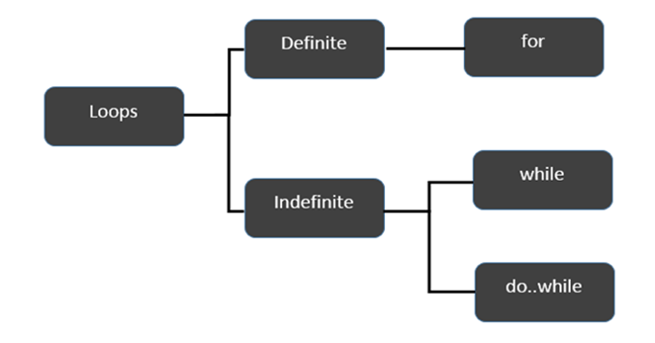
Loop Logic Structure

Slide 38
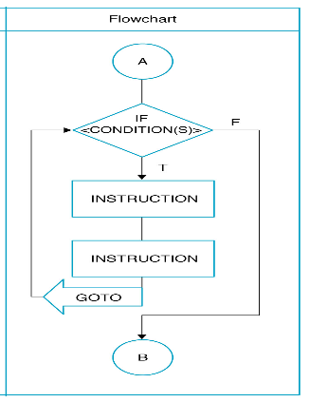
WHILE Loop
Start
While (In FAST)
Eat
Sleep
Code
End

Slide 39
Practice Problem
Write a pseudocode to Print Hello World for 5 times using While Loop.

Slide 40
Practice Problem
Write a pseudocode and make a flowchart to read 10 numbers from keyboard and find their sum and average using while Loop.

Slide 41
Practice Problem
Make a flowchart and write a pseudocode for a program which calculates the sum of 100 integers 1, 2, 3, …, 100.

Slide 42
While Loop with an iterator
Make a flowchart for a program which calculates the sum of 100 integers 1, 2, 3, …, 100.
Set count to 0
Set total to 0
While (count<=100)
count=count+1
total=total+number
End while
Display total

Slide 43
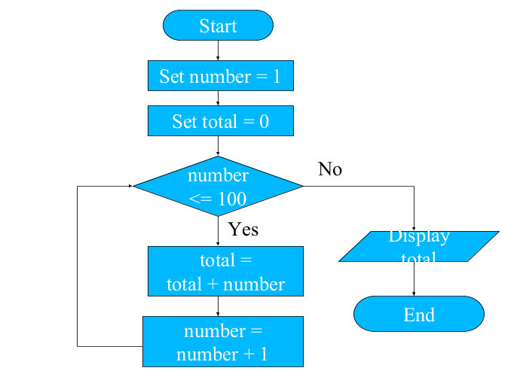

Slide 44
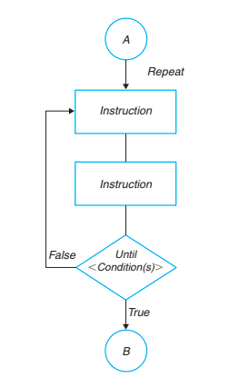
Do While Loop
Start
Do
// Loop
While (condition )
End while
End

Slide 45
Practice Problem
Write a program to keep asking for a number until you enter a +ve number using do while loop.

Slide 46
Problem
Make a flowchart for a program which ask the user for the password until it matches with the actual one.
Make a flowchart for a program which ask the user for the password. If it doesn’t match in 3 trials, it shouldn't ask again.

Slide 47
Home Assignment
Make a flowchart and write a pseudocode to print first 50 even numbers.
Make a flowchart and write a pseudocode to sum n numbers until sum < 40.
Make a flowchart and write a pseudocode to read an age of 15 person & find out how many of them fall under :
a) Still a baby- age 0 to 5
b) Attending school - age 6 to 17
c) Adult life-age 18 & over

Slide 48
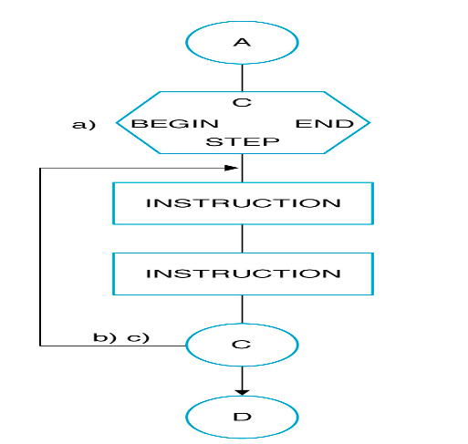
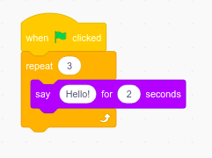
For Loop
For i=1 to n
Do something
Do something
End for

Slide 49
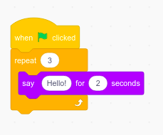
Print Hello World for 5 times.
Write a pseudocode and make a flowchart to read 10 numbers from keyboard and find their sum and average.

Slide 50
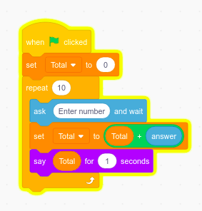
Write a pseudocode and make a flowchart to read 10 numbers from keyboard and find their sum and average.

